Slide 1

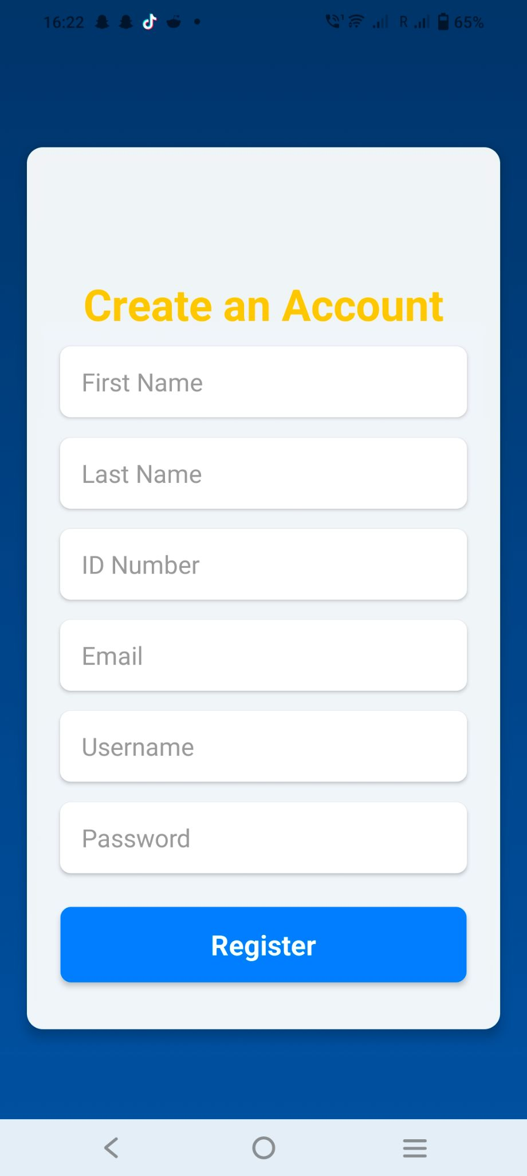
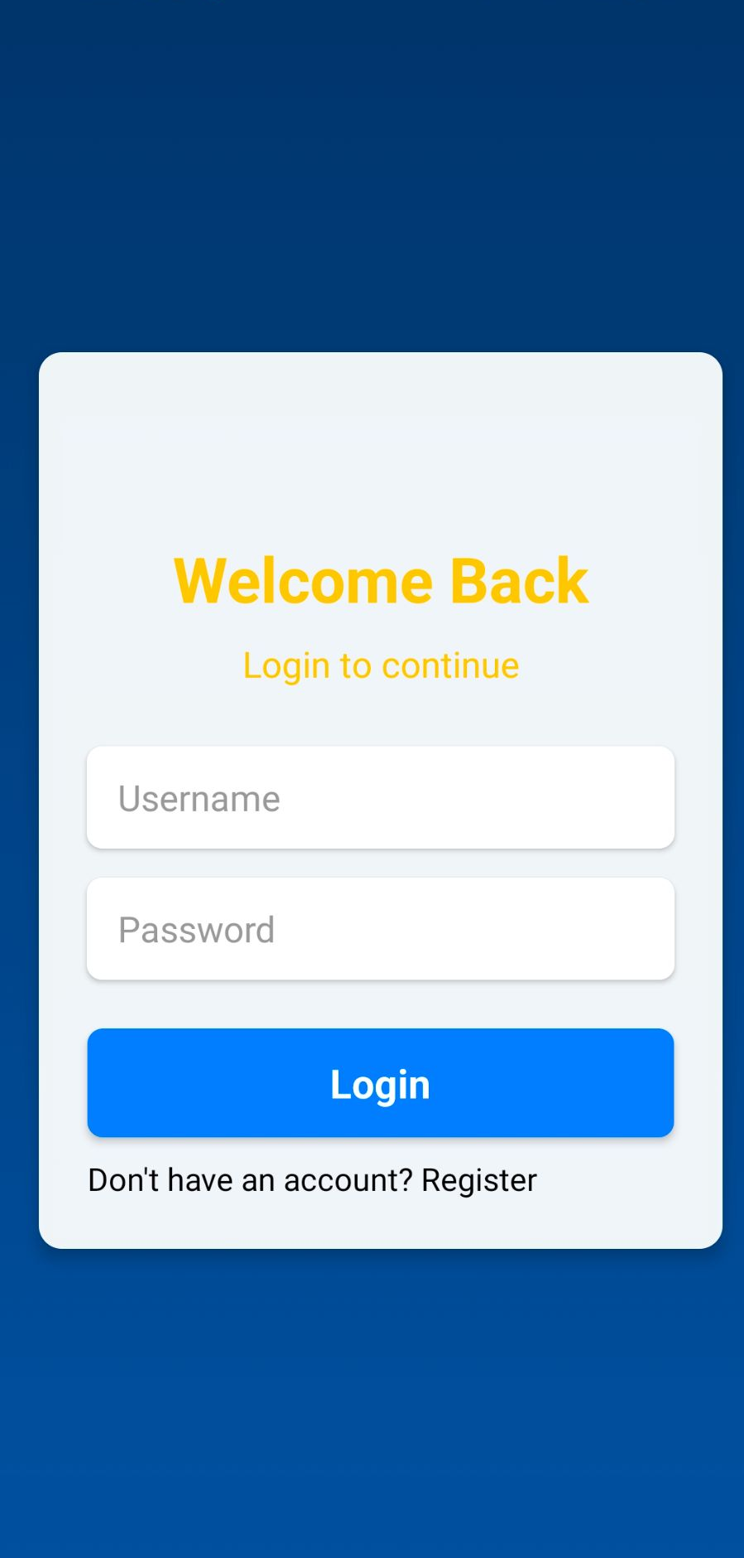
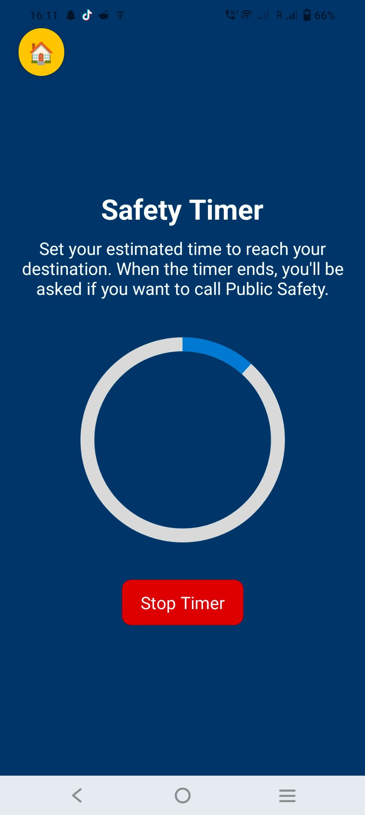
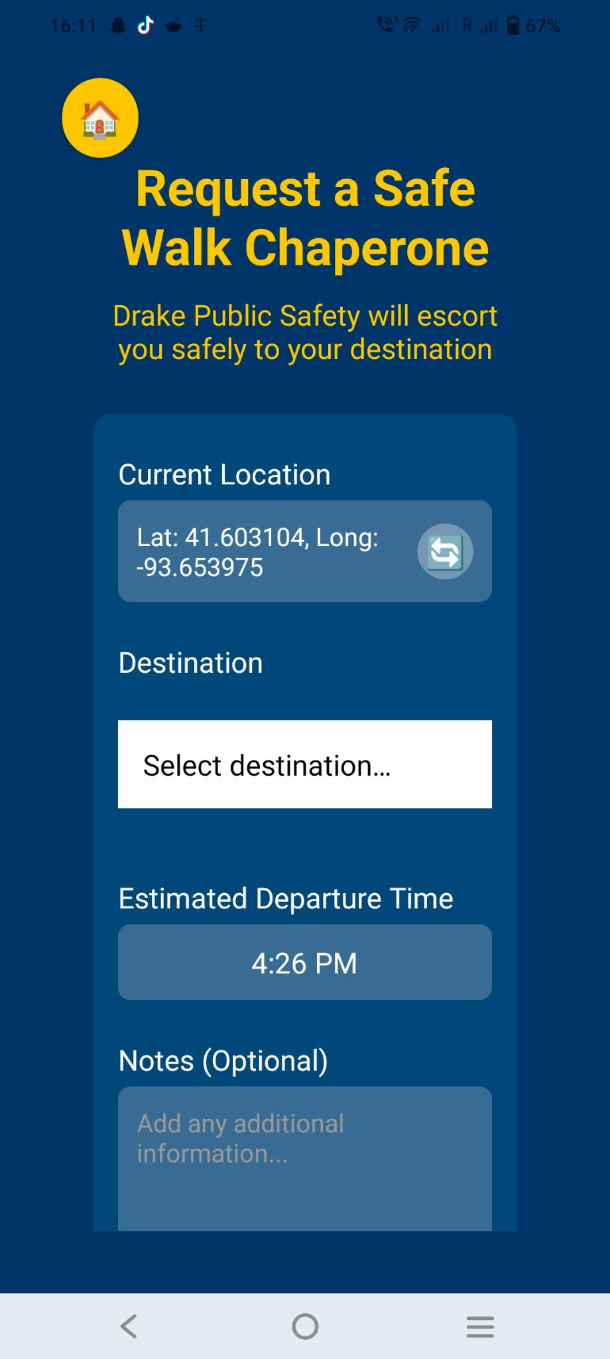
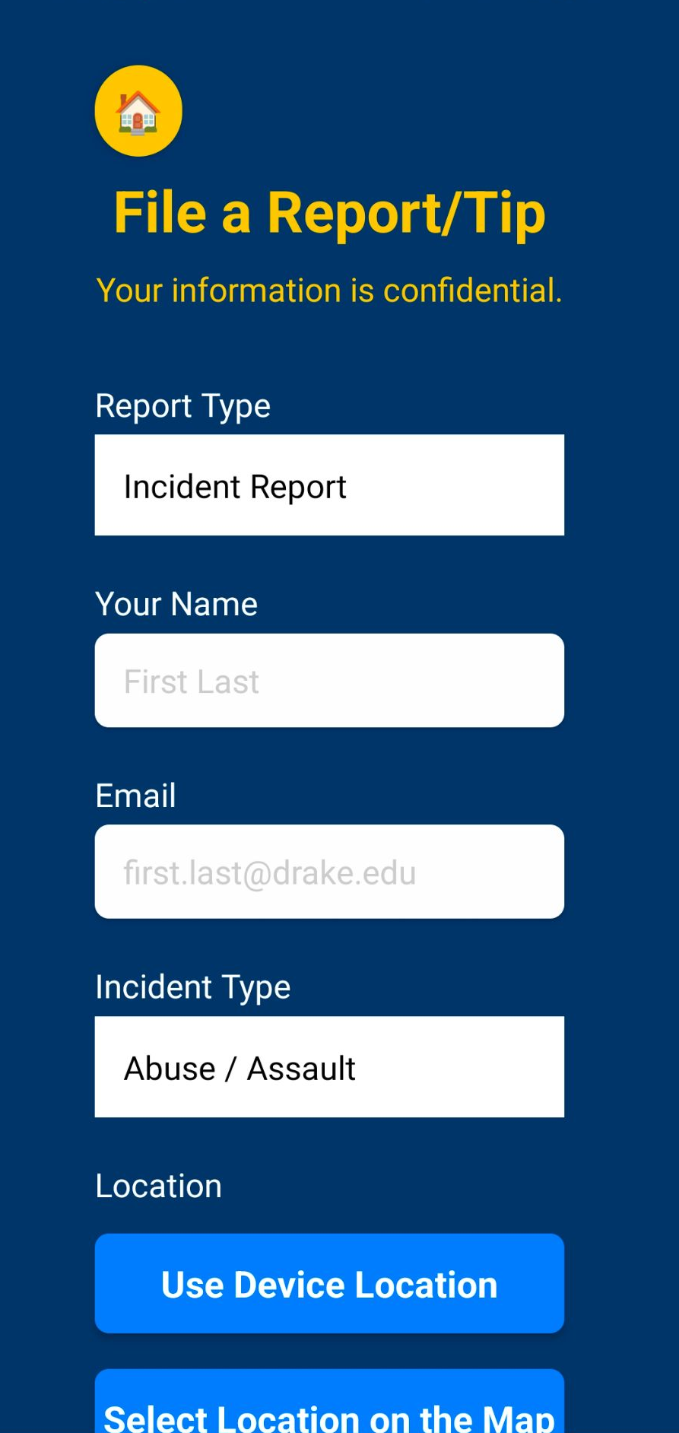
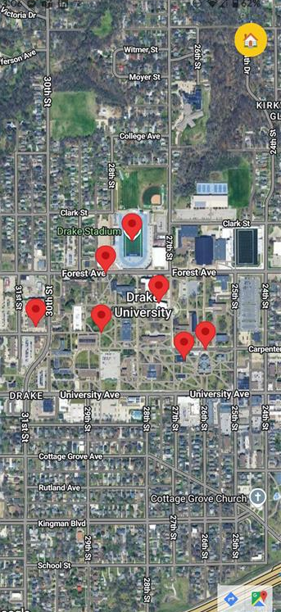
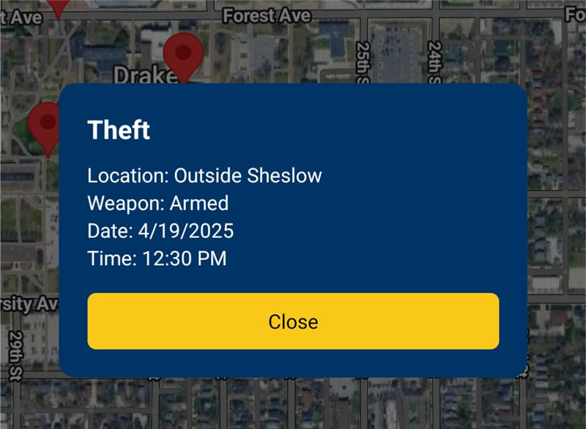





Campus Safety App
Hannah Andersen, Bridget Brombach, Ahana Yelagar
Drake University Computer Science Capstone
Home Screen
Register Page
Login Page
Safety Timer
Safe Walk Page
Report/Tip
Page
Map of
Reports/Tips
About the App
Why We Created It
Differentiating Factor
Tech Stack
Our Campus Safety App is a comprehensive campus safety app designed to empower students with real-time tools to protect themselves and their community. Built with essential features like login and registration, an emergency help button, incident reporting with optional anonymity, safe walk requests, a safety timer that alerts public safety if needed, and an interactive map of reported incidents— our app bridges the gap between students and safety in moments that matter most.
We built this app because we believe no student should ever feel alone when it comes to their safety. Our goal was to create an accessible, proactive solution that makes it easier to report concerns, reach help fast, and stay informed. By combining technology with empathy, our Campus Safety App helps foster a more secure and connected campus for everyone.
We're aware that Drake University currently uses Rave Guardian for similar services, however we've found that this app is missing some key features that we've implemented:
The ability to file reports directly
A live updated map that shows recent reports on campus
Drake University specific branding and geolocation

